Slide 1
1.6
ALTERNATING
SERIES
Alternating Series
Alternating Series Test
Absolute Convergence Test
Absolute Ratio Test
Root Test

Slide 2
ALTERNATING SERIES
EXAMPLES
An infinite series of the form
or
where
is called an alternating series.

Slide 3
ALTERNATING SERIES
TEST (AST)
EXAMPLES
The alternating series
or
i. Let
converges if both condi-tions are satisfied:
i. for all
ii.
ii.
Thus, the given series is convergent by AST.

Slide 4
EXAMPLES
ii.
Let
Thus, the given series is convergent by AST.
i. Let

Slide 5
DEFINITIONS
EXAMPLES
The infinite series
is said to be
is conditionally convergent.
i. absolutely convergent
if is convergent.
ii. conditionally convergent
if is convergent
is absolutely convergent.
but is divergent.

Slide 6
THEOREM
An infinite series that is absolutely convergent is convergent.
EXAMPLES
are both convergent since both are absolutely convergent.

Slide 7
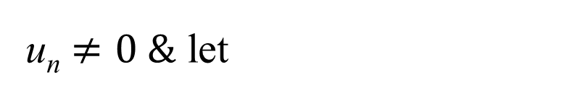
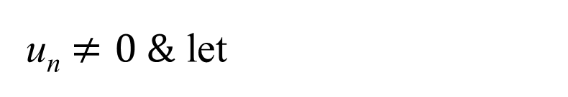
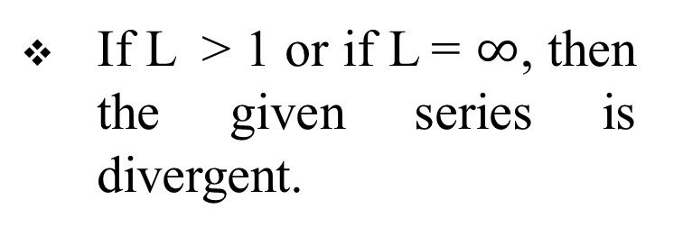
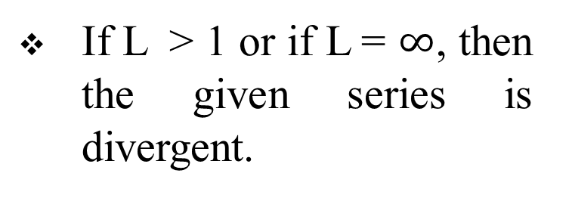
ABSOLUTE RATIO TEST
ROOT TEST
Let be a series for w/c
Let be a series for w/c
u_{n} $≠0 \&$ let
u_{n} $≠0 \&$ let
If L < 1, then the given series is convergent.
If L < 1, then the given series is convergent.
If L > 1 or if L = $∞$, then the given series is divergent.
If L > 1 or if L = $∞$, then the given series is divergent.
If L = 1, test fails.
If L = 1, test fails.

Slide 8
EXAMPLES
Thus, by the Ratio Test, the series is convergent.
Thus, by the Ratio Test, the series is convergent.

Slide 9
EXAMPLES
Thus, by the Root Test, the series is divergent.
END

